Slide 1

Football Prediction Model - Data Engineering
Ardeshir / Jinseo / Dhruv / Rachel / Devi

Slide 2
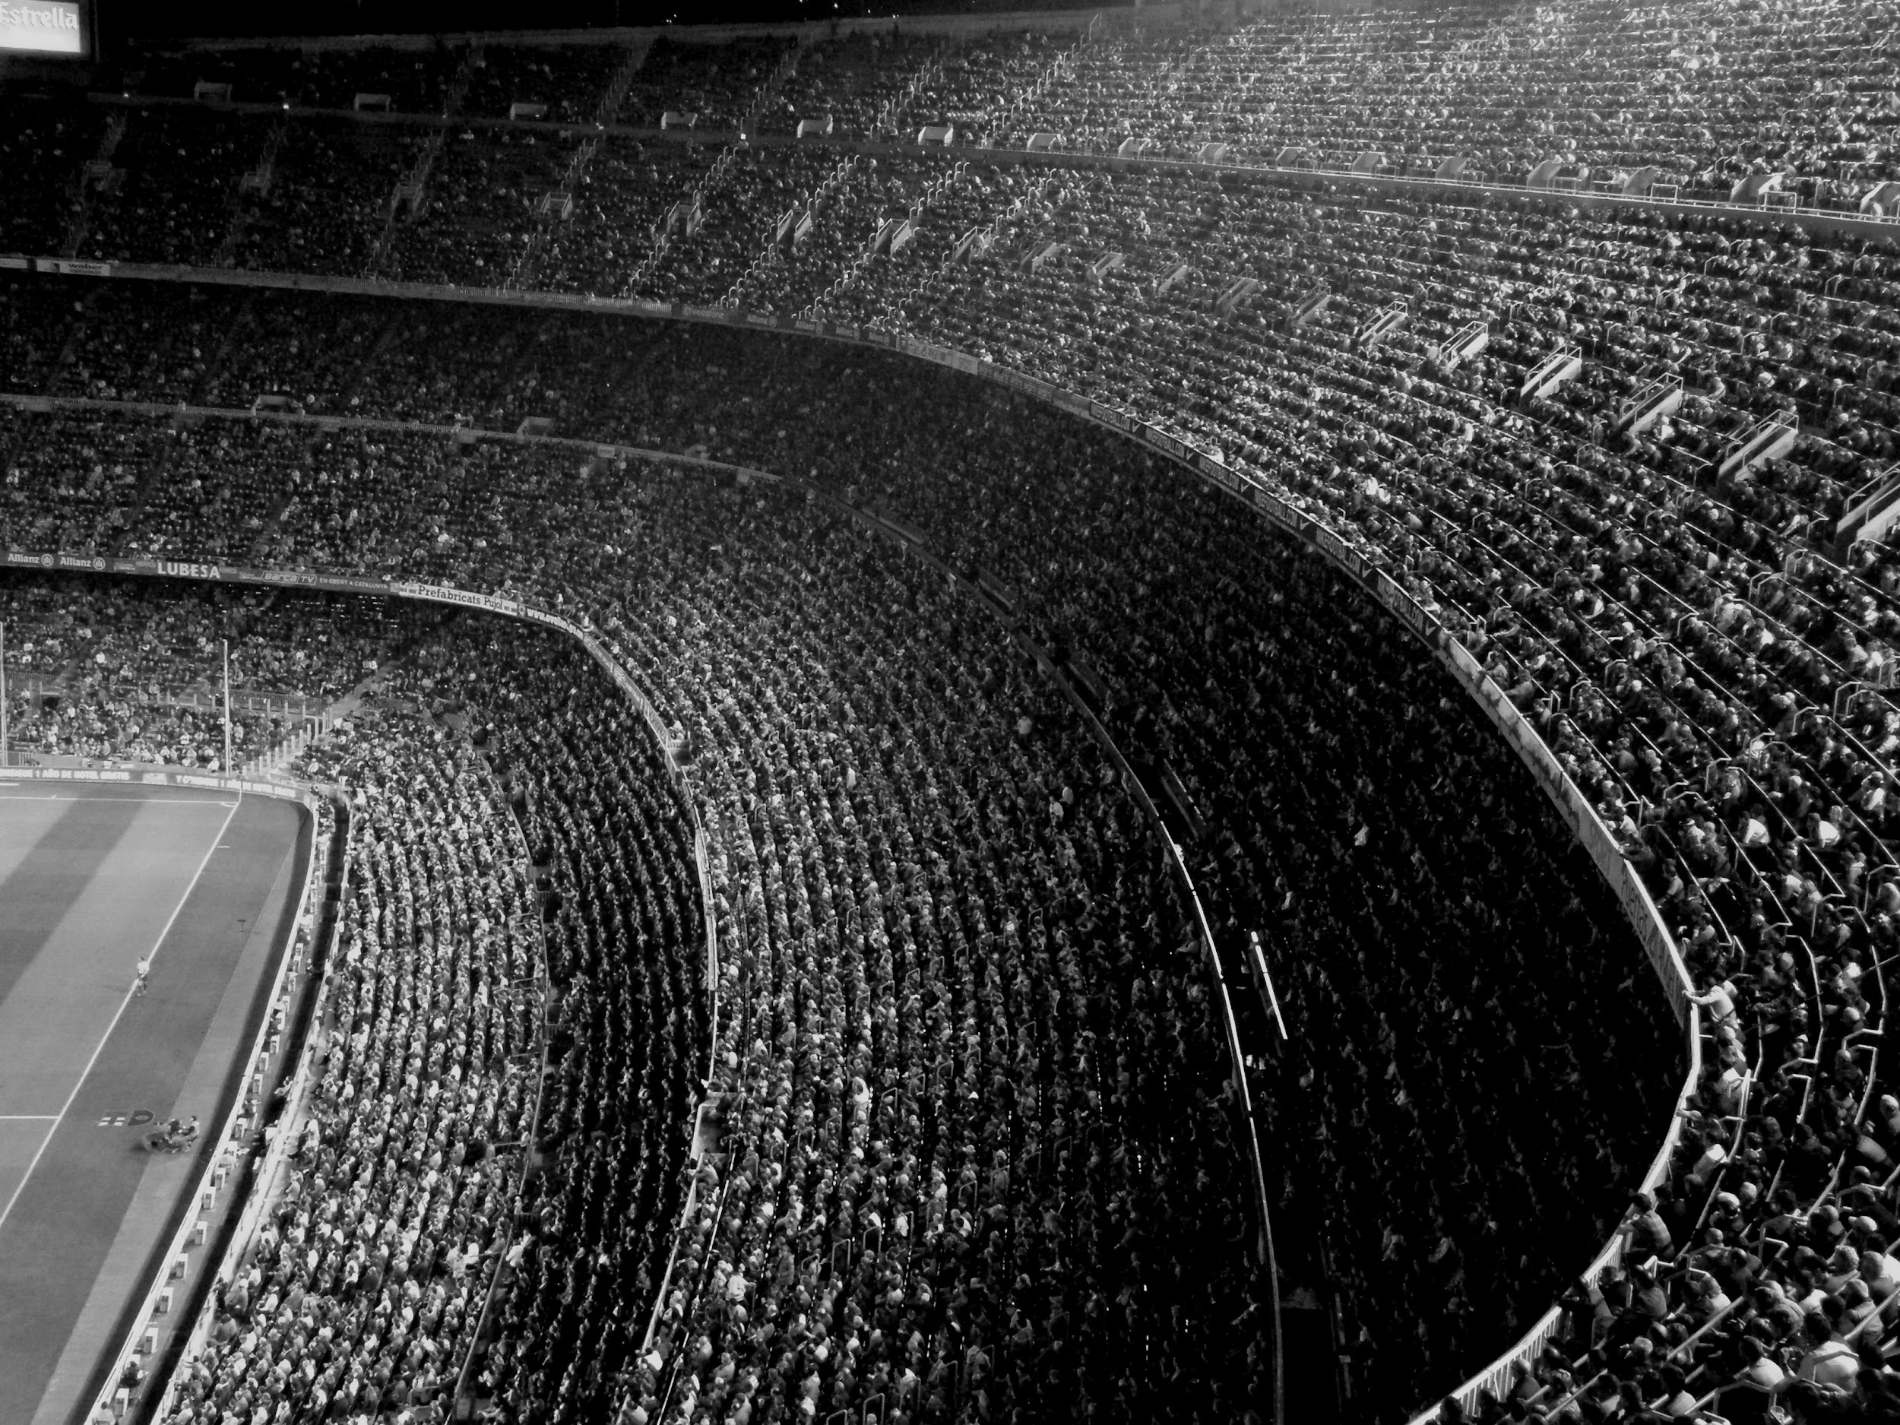
Topics of Discussion
Data Cleaning and Ethics
Exploratory Data Analysis
Data Visualization
Database Creation
Data insights

Slide 3

Data Cleaning and Ethics
Focused on ensuring data quality and integrity.
Handling Missing and Irrelevant Data
Feature Engineering and Data Transformation
Ethics

Slide 4

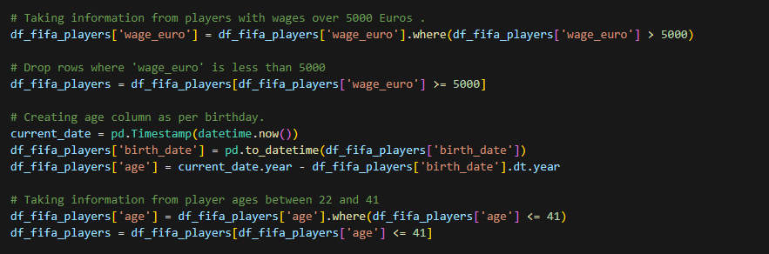

Slide 5
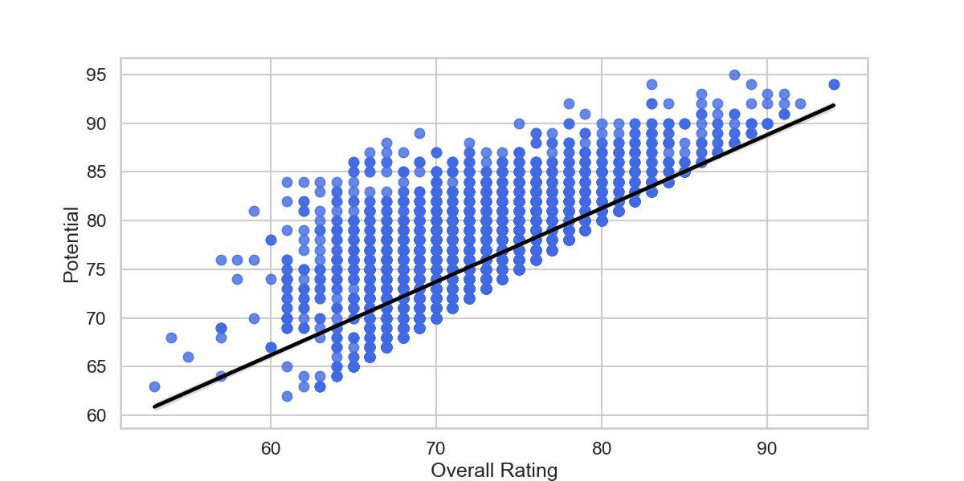
Analysis of Player’s Rating and Potential

Slide 6
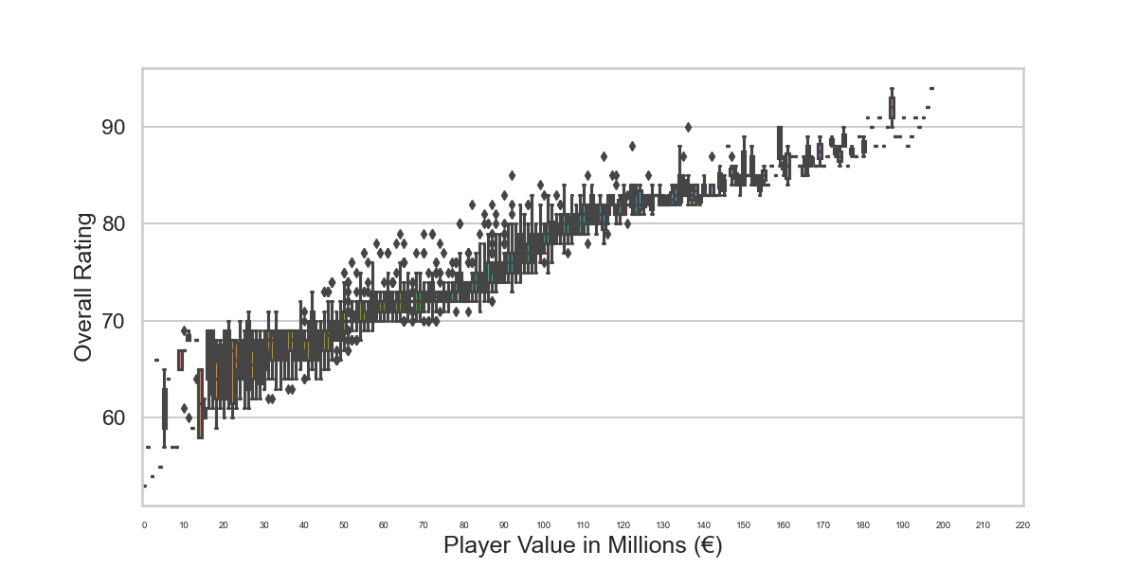
Analysis of Player’s rating and value

Slide 7
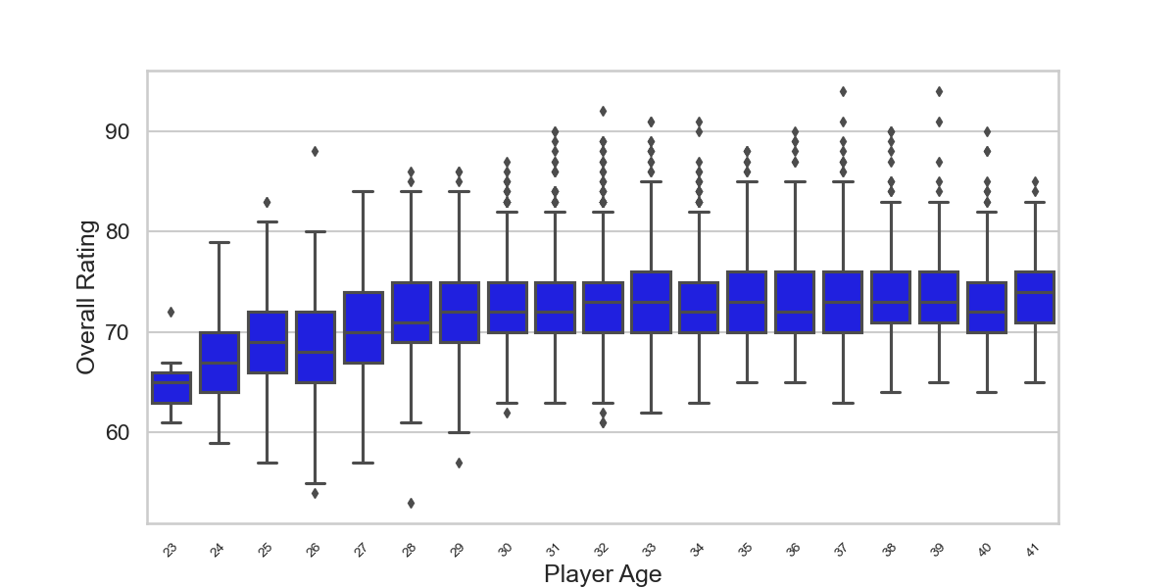
Analysis of Player’s rating and the age

Slide 8
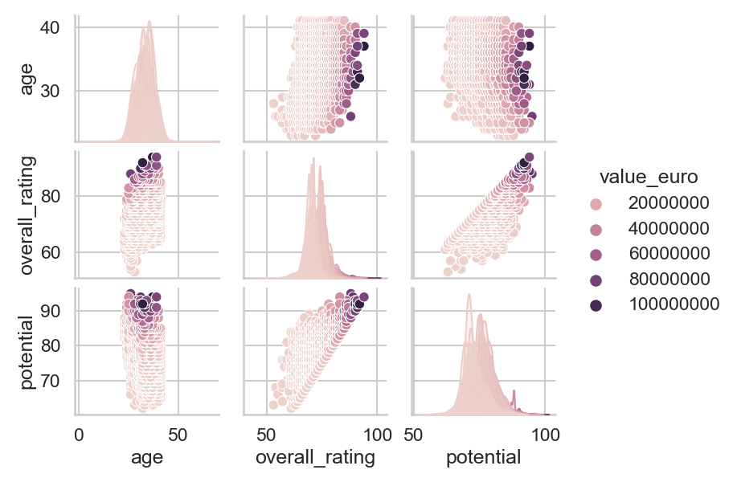

Slide 9
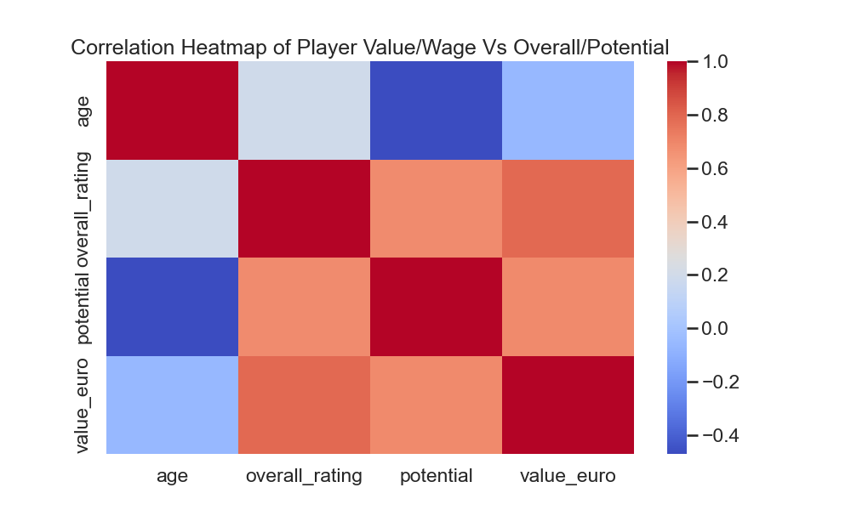

Slide 10

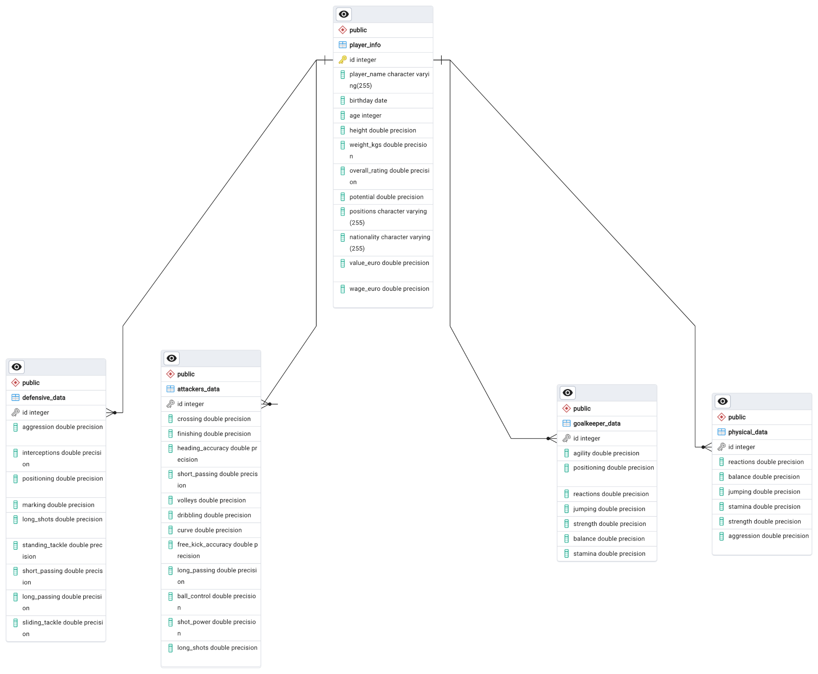


DataBase Creation
Player_info - > Primary Key
Attackers_data,Physical_data,Goalkeeper_data
Defensive_data

Slide 11
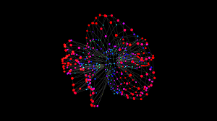
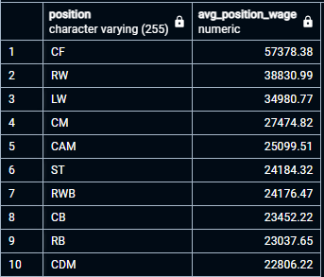
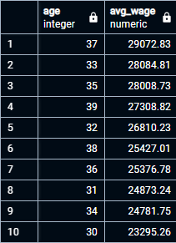
Data insights from SQL
Average of Rating/Wage/Value by Position
Impact of Age on Wage/Value

Slide 12

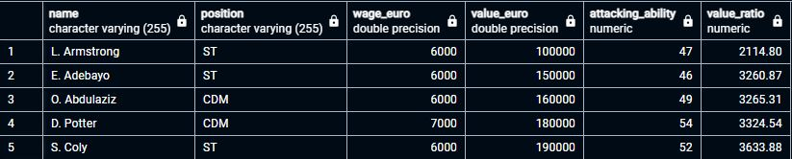
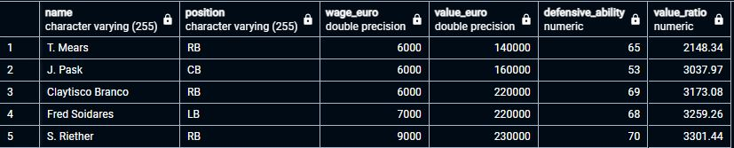
Value Based on Cost
Most Value for Money Attacking
Value for Money Defensive players

Slide 13

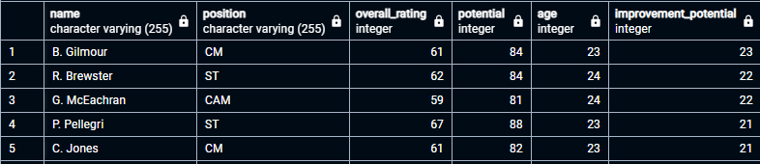
Top Players by Improvement Potential

Slide 14
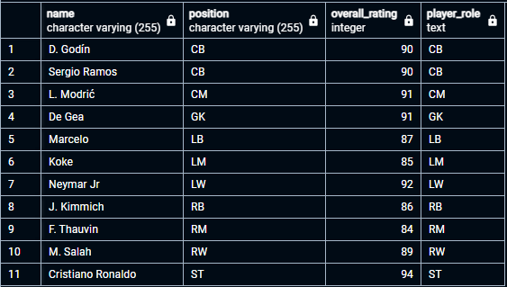

DREAM XI

Slide 15



